Slide 1
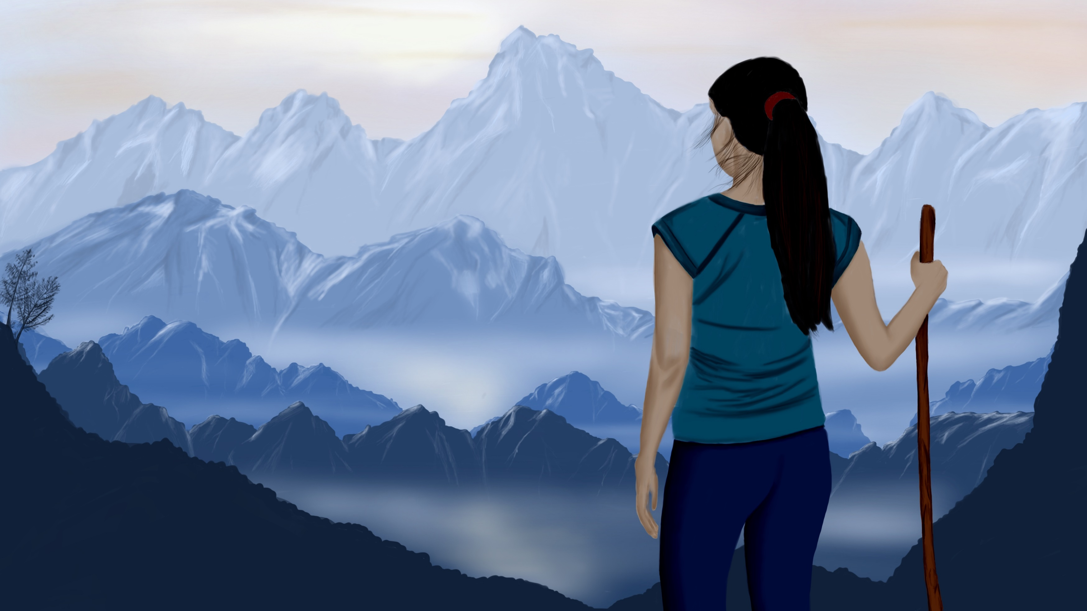
Visualize your research narrative

Slide 2
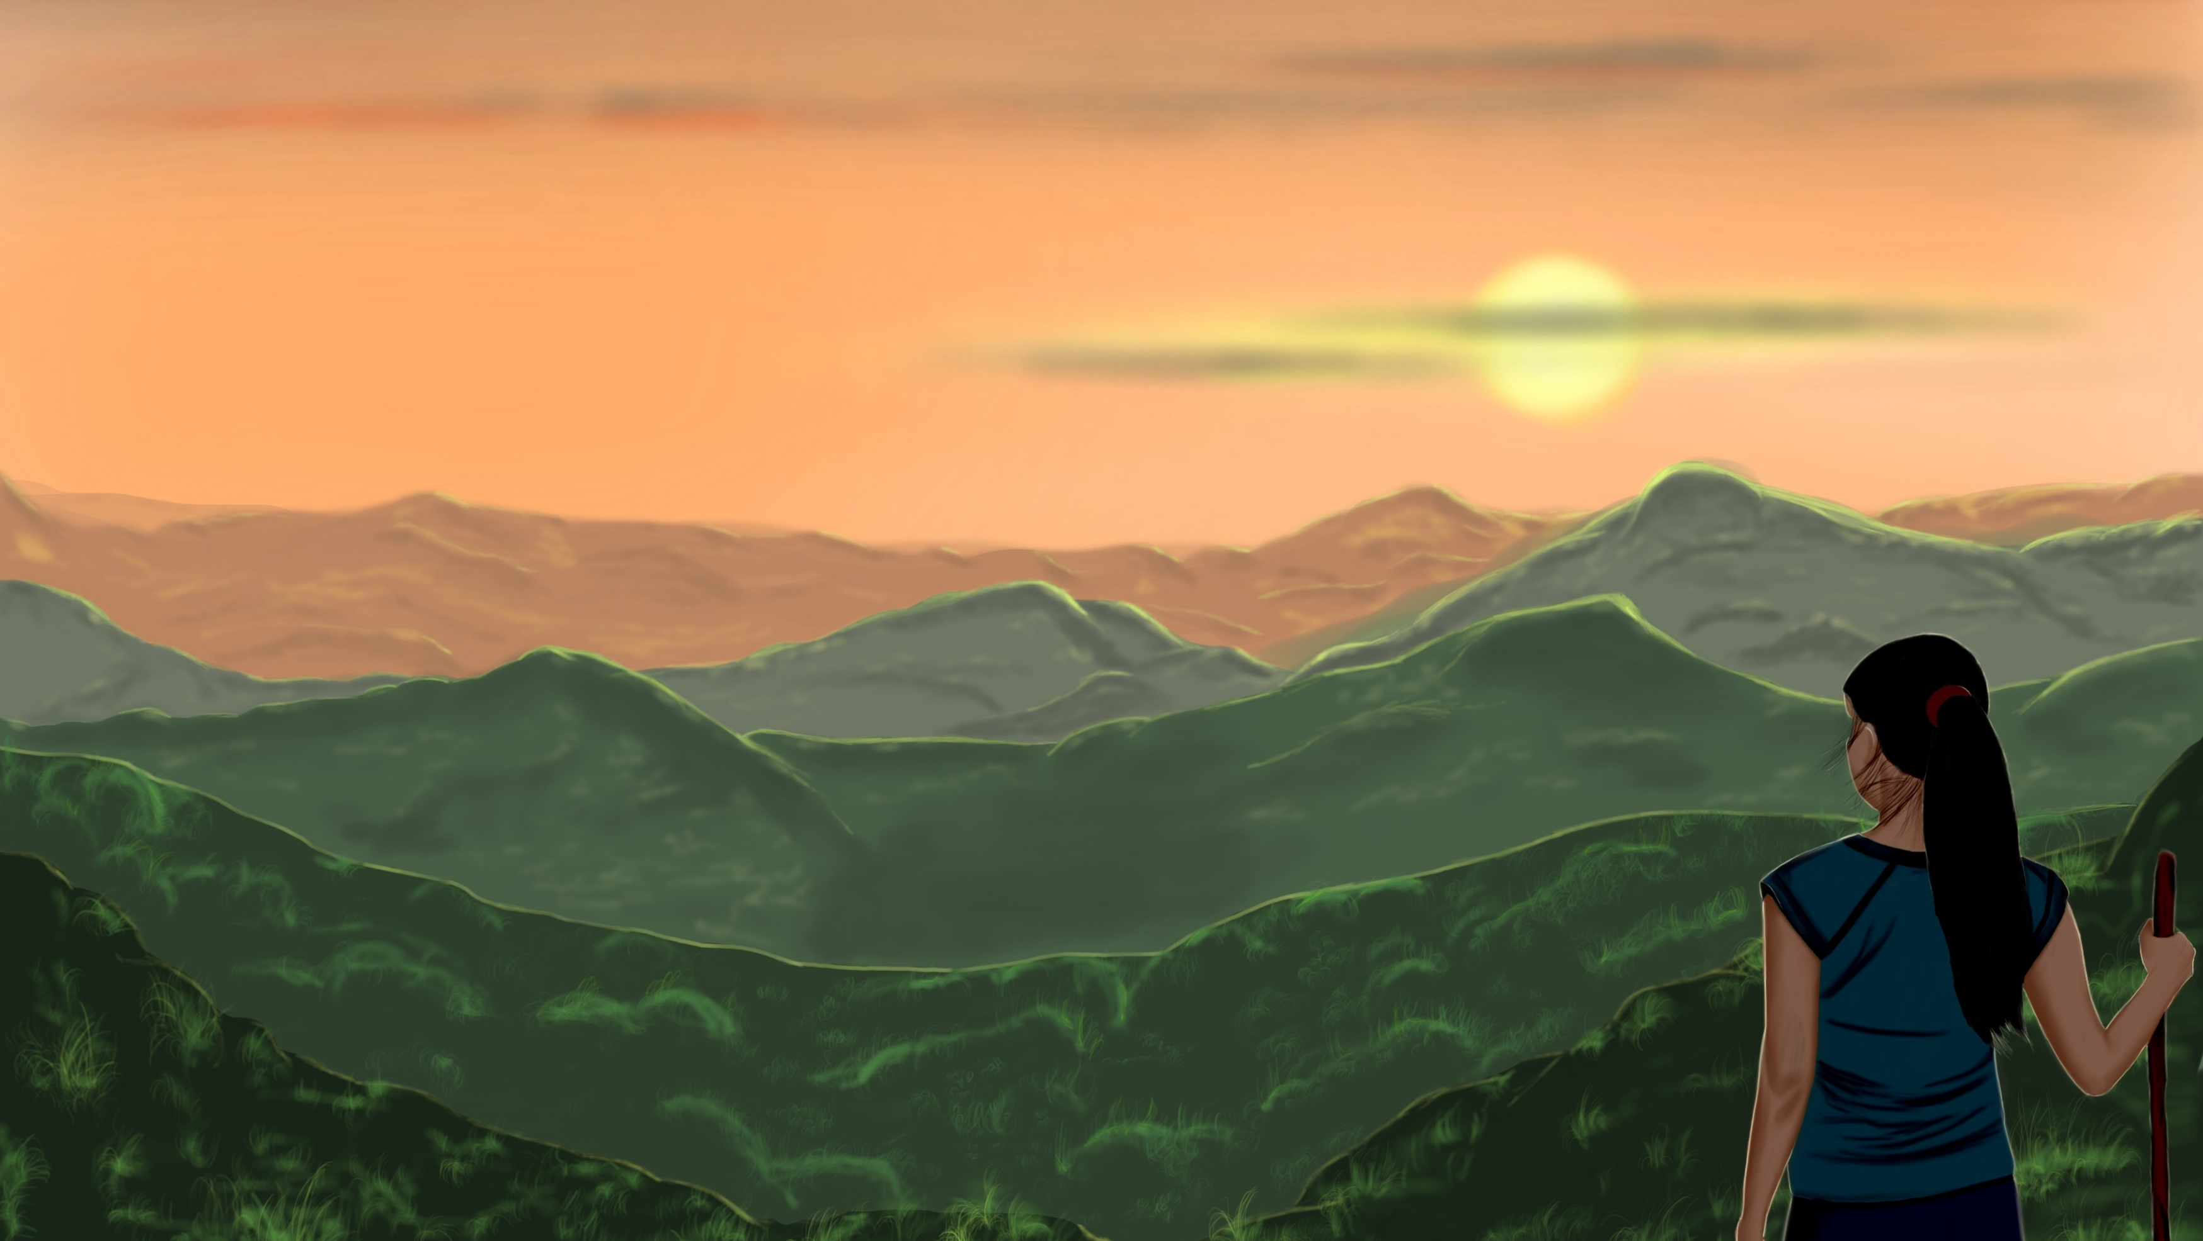
Using the right mental models to think about our research can make the journey smoother and keep us focused even when times are tough.
You might find that visualising your research journey can help you communicate with your supervisor about research and personal matters.
It might give you a shared metaphor to use when you don’t feel able or willing to disclose personal information.
Think about the following questions, and then create your own metaphorical landscape and map using the materials below.

Slide 3
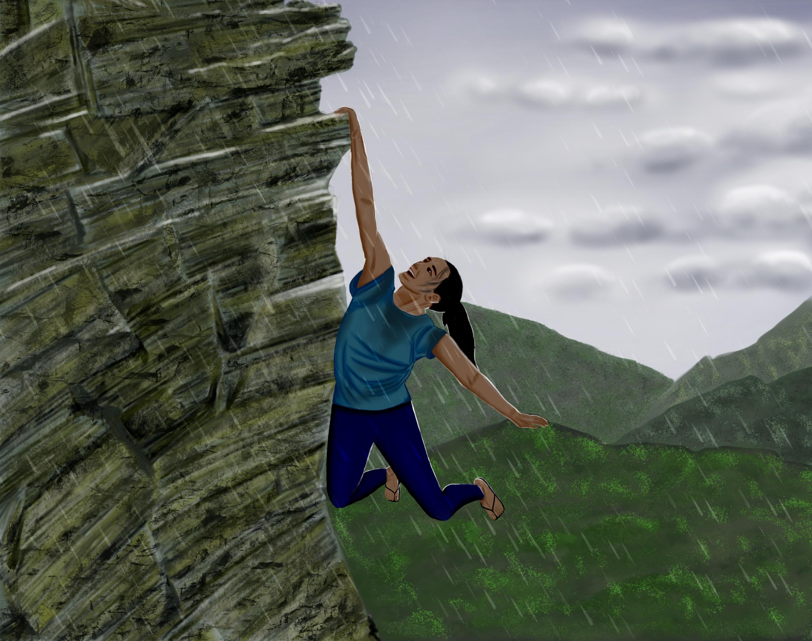
Your Research:
How do you currently think about your research?
Are you on a journey?
Do you have a destination in mind?
How are you going to get there?
What happens along the way if things go wrong?

Slide 4
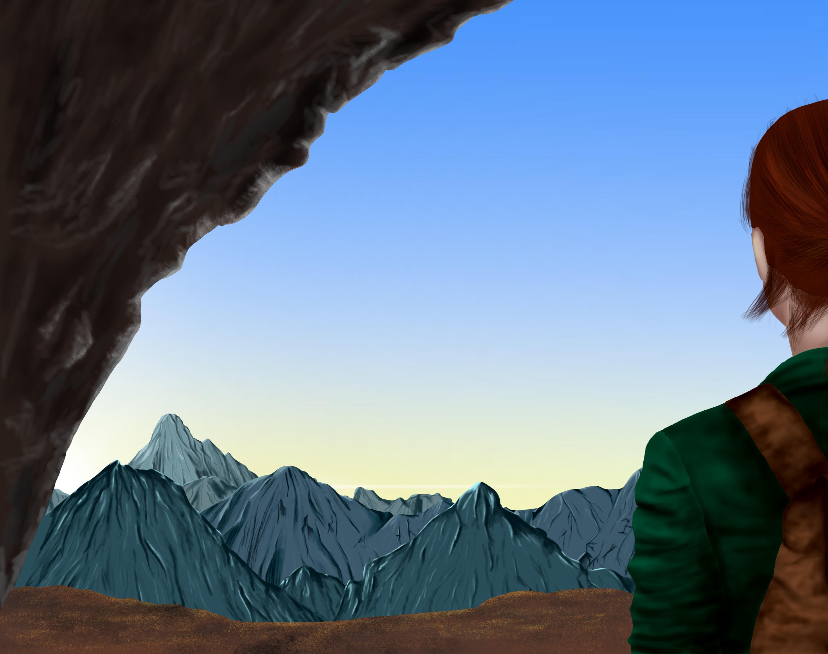
Your Landscape:
You might wish to think about your current research project as a journey, with the successful completion of the project as reaching the top of a mountain.
Can you imagine yourself in a landscape with different features? What does it look like? Can you see the summit of your mountain in the distance?
  Where are you in your landscape?
  What can you see?
  What can you feel?
  What can you hear?
  Can you see a clear path to your mountain?

Slide 5
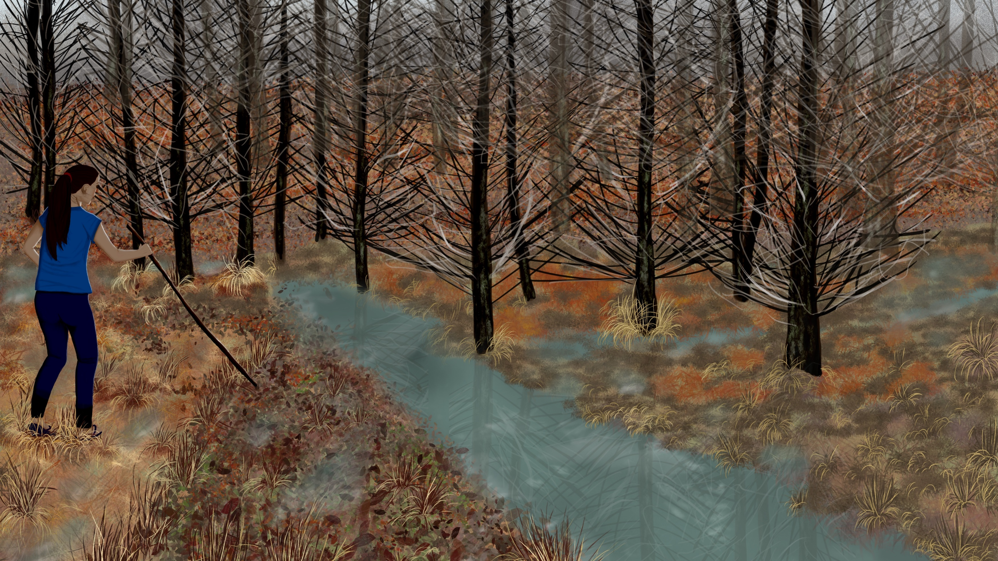
Your Landscape:
Then, thinking about your research and your other life commitments, how might these appear in your landscape?
For example:
REAL WORLD: | METAPHOR:
“I’m feeling really unmotivated about my research” | “I’ve wandered into a fog and can’t see where I am”
“I’ve read so much literature that I’ve lost sight of my original research question” | “I’ve trekked into a forest but now can’t see the way out”
“I’m trying to push on with my research but there’s so much happening in my personal life that I feel like I’m failing at both” | “I’m trying to climb a rock face in the middle of a storm”

Slide 6
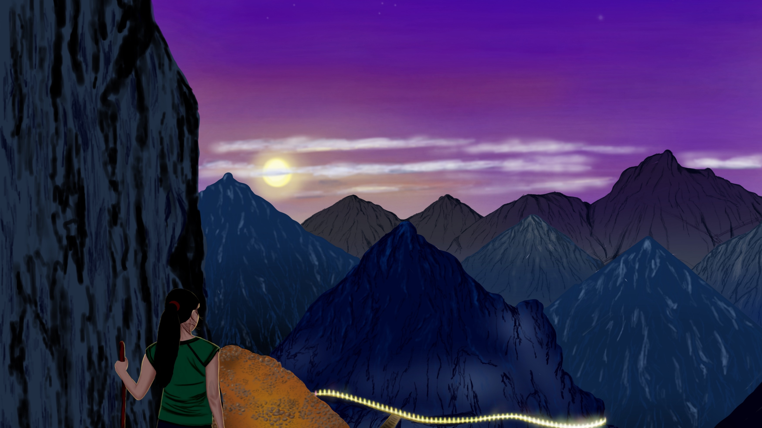
Your Landscape:
Or, you might feel that things are going pretty well:
REAL WORLD: | METAPHOR:
“I think my research is going well and I’m enjoying it” | “I find this climb rewarding and I’m enjoying the views”
“I’ve met other researchers who have encouraged and inspired me” | “I can see other climbers in my landscape”

Slide 7
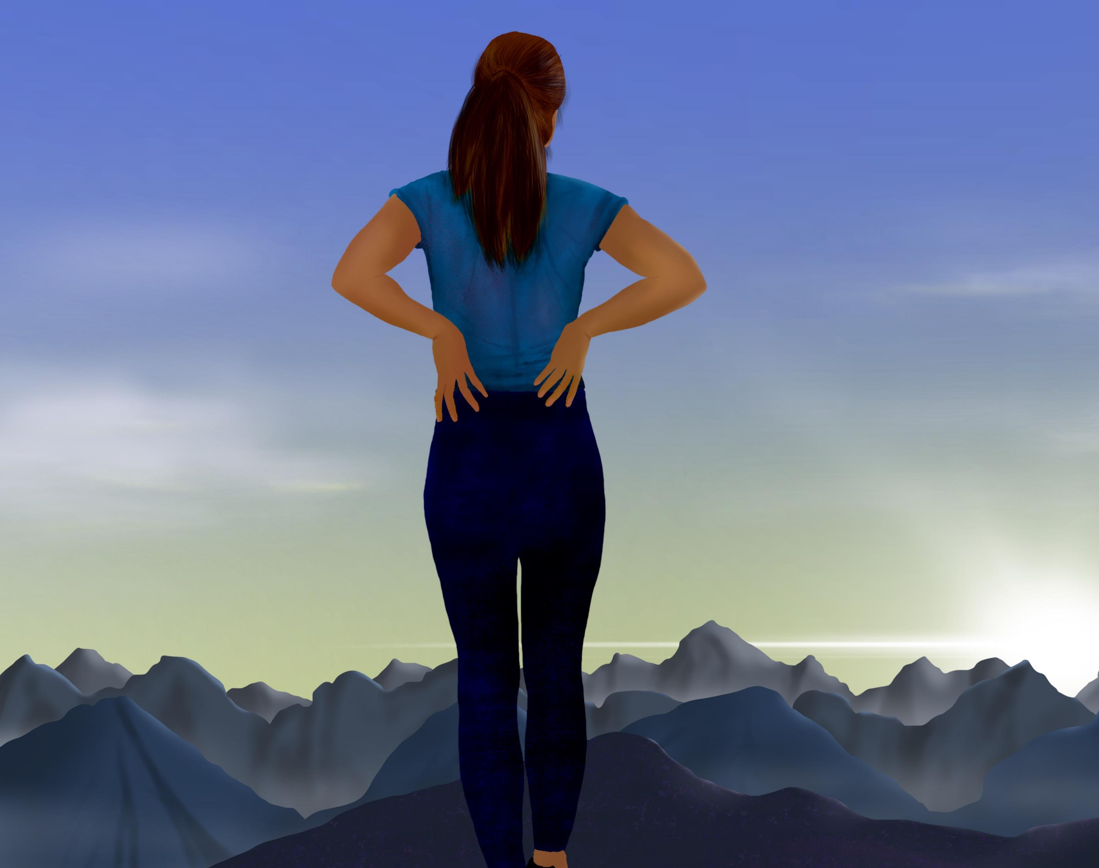
Your Journey:
Use the blank map and some of the landscape features on the following pages to get started. Feel free to add in extra features. Then:
Where are you on the map currently?
How near are you to your mountain?
What obstacles are between you and your mountain?
You might want to share this metaphor with your supervisor and show them your map and where you think you currently are. Do they agree?

Slide 8


Slide 9
